Slide 1

ProtoControl
Kelly Mae Allen, Abisha Fenn, Nida Kosedagi, Parker Sexton, William Wood

Slide 2
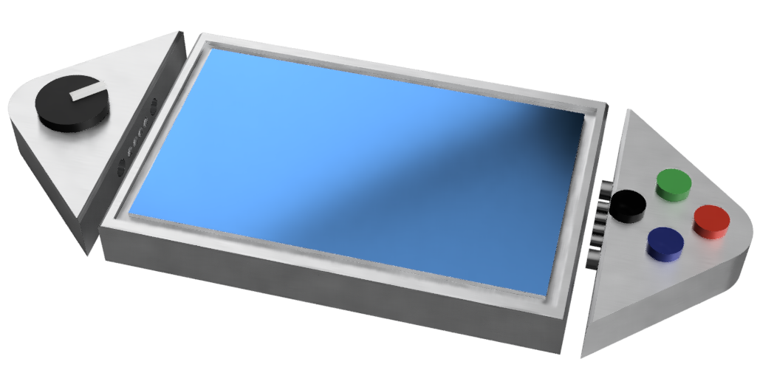
What is ProtoControl?
A plug and play panel with a start-to-finish user interface development experience.
Software platform to design user interface layout
Auto generated embedded code
Touch-screen display
Hot swappable hardware
Compatibility with industry standard technology
Notes:
Protocontrol allows engineers and hobbyists to execute their vision for a user interface panel with a start-to-finish user interface development experience
Bring the audience to the same place as us before diving into details, set the tone, differentiate ourselves from other projects

Slide 3





Meet The Team
Kelly Mae Allen (Team Lead)
Enclosure modeling & Power
Embedded software integration
Parker Sexton (Project Sponsor)
Embedded Software Integration
Software/website, Custom PCB design
Will Wood
Software and Website to Design Digital UI
Nida Kosedagi
Custom PCB Design
Serial Communication IC
Abisha Fenn
Serial Communication IC
Enclosure Modeling & Power

Slide 4
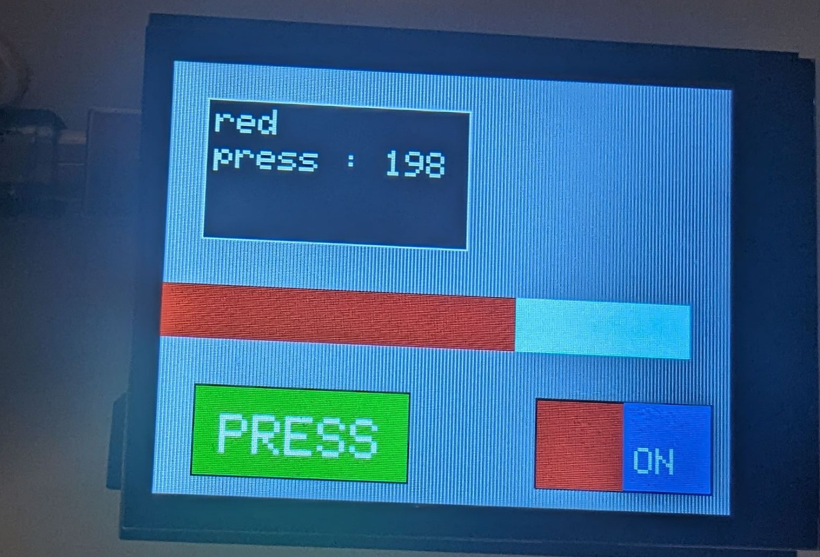
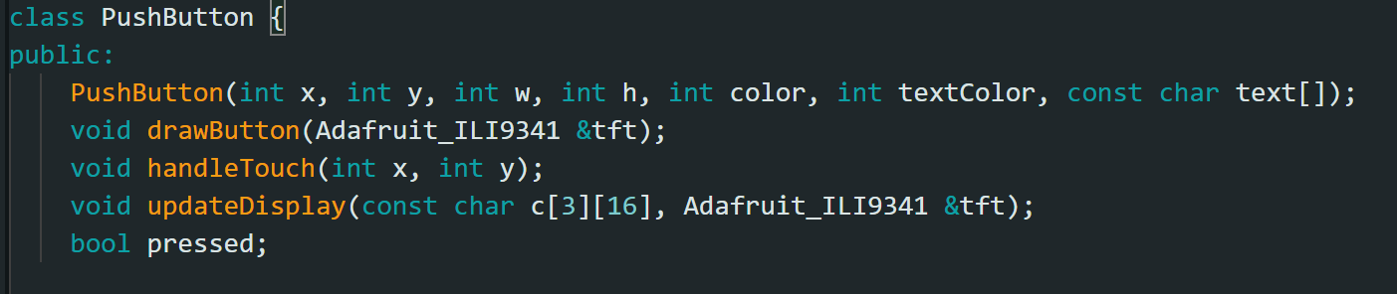
Embedded Progress
Updated for capacitive screen
Classes for screen icons
Positioning based on input from software
Dynamic updating
Challenges:
Communication Methods

Slide 5
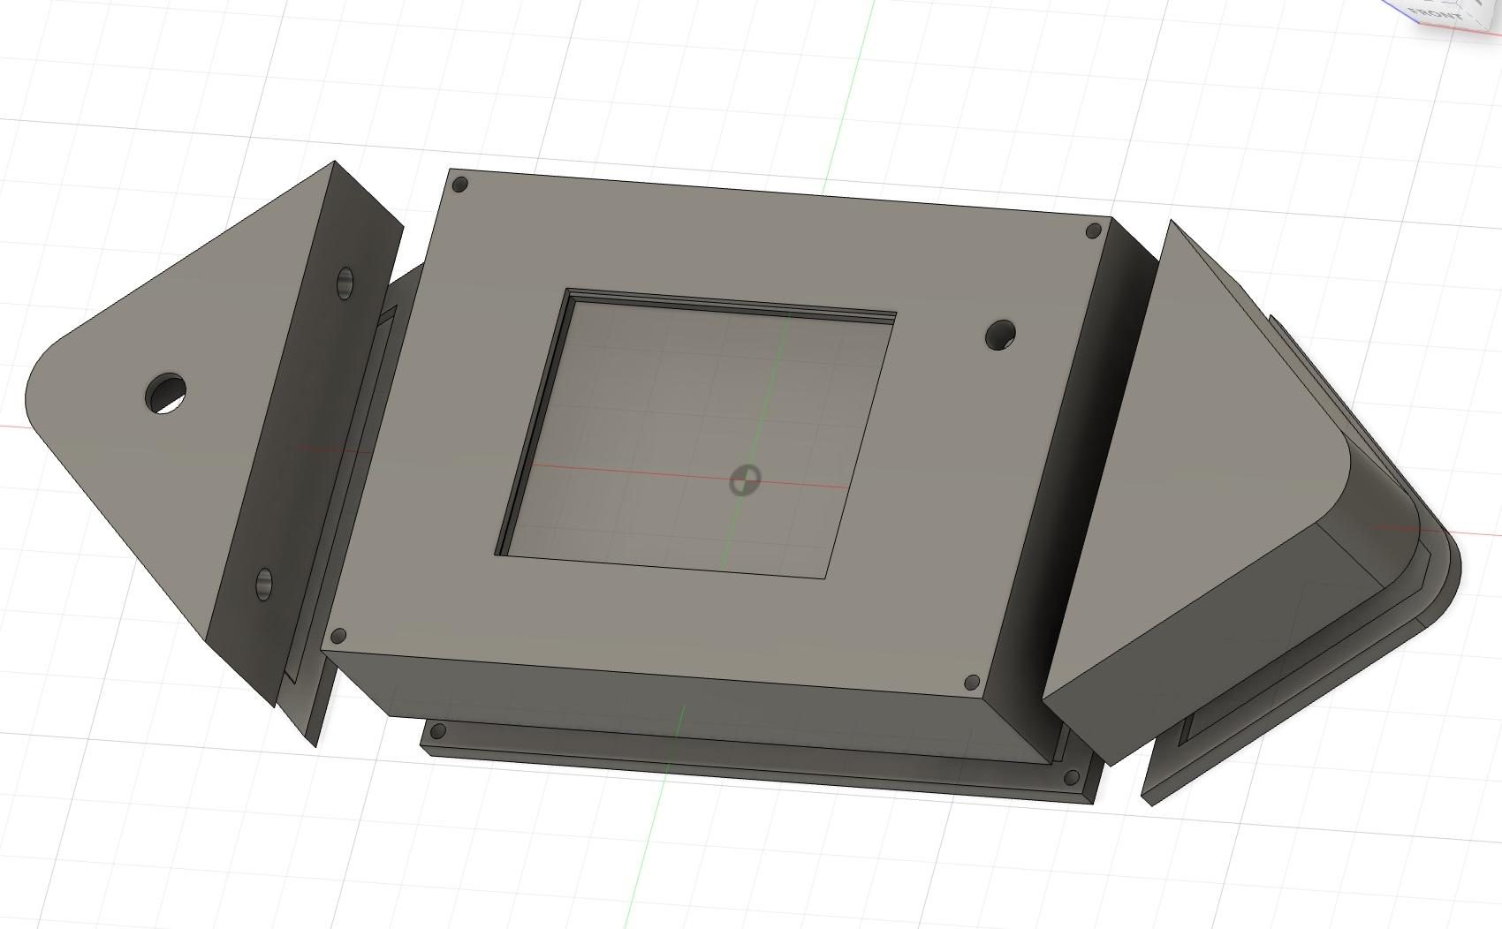
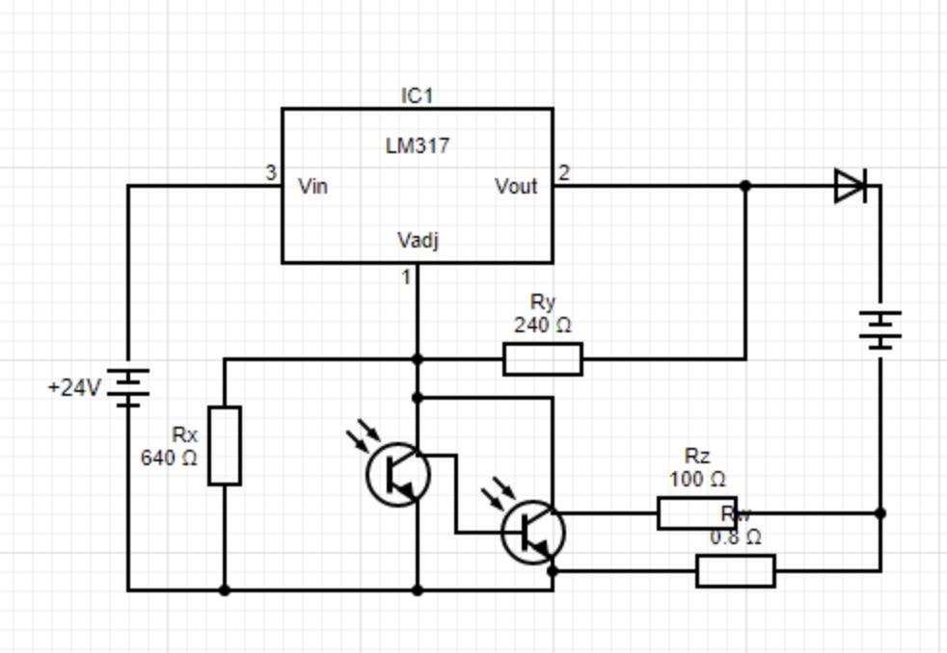
Enclosure / Power system progress
New enclosure designed
Need specifications on part sizes for peripherals
Using a LM317 regulator for charging
Need power draw of full device
Working on regulator circuit
Need to know current draw
Learning about power path circuits
Need to study what kind to use
https://www.wellpcb.com/Li-ion-charger-circuit.html#:~:text=How%20it%20works,It%20initiates%20the%20charging%20process.

Slide 6
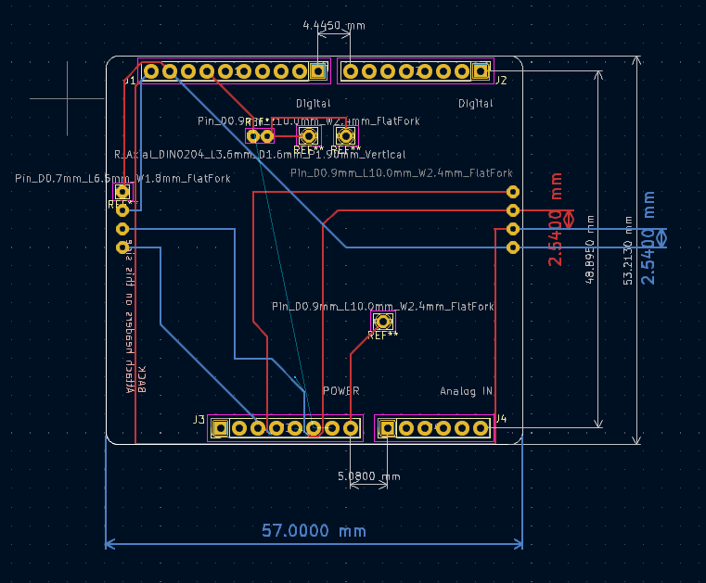
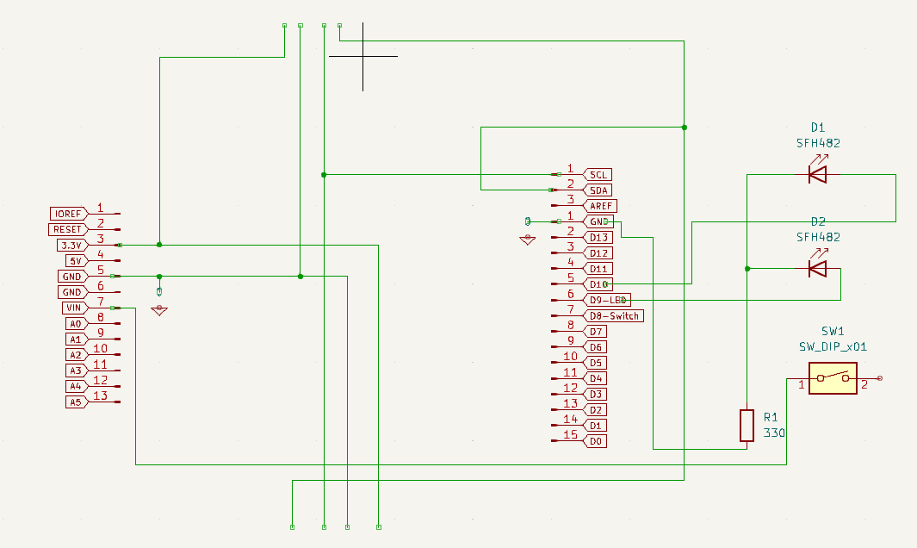
PCB design progress
Progress: Schematic and PCB designed
Lessons Learned: Need autorouting, printing different versions will be helpful, learning footprints and netlists
Next Steps: PCB training and first PCB to be printed on Oct. 31

Slide 7
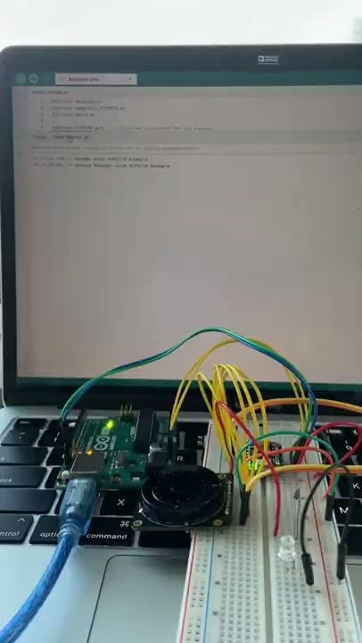
Hardware Design + Serial Communication progress
Successfully interfaced PCF8574 GPIO Expander with a Rotary Encoder (non-I2C to I2C)
Lessons Learned:
Troubleshooting Port not Found Errors
MCP23017 is not compatible with Rotary Encoder
Theory: it’s digital read is different than that of the Arduino Uno
Next Steps
Interface keypad, slider, and toggles
Buy TIs PC8574 IC and make a Schematic for PCB (replicate the pin expander)
Continue Verilog Modeling of I2C
Notes:
People Responsible: Abisha, Parker
Next Steps
Interface keypad, slider, and toggles
Buy TIs PC8574 IC and make a Schematic for PCB (replicate the pin expander)
Continue Verilog Modeling of I2C
Explore what modules we have available to us with Vivado

Slide 8

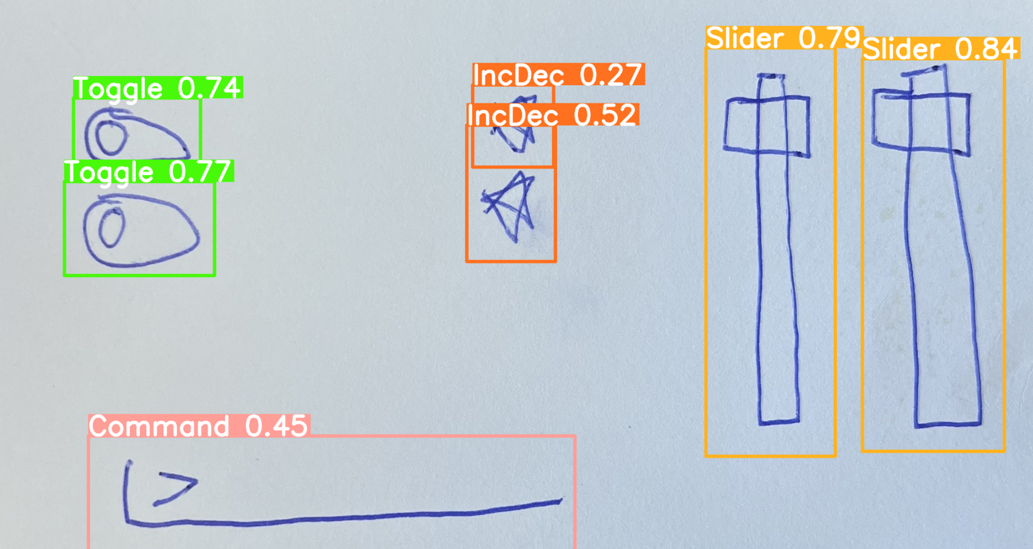
Software Progress
What’s been done:
Optimized image processing & object detection algorithm
New round of training data coming soon
Added and refactored templated embedded code
Looked into web hosting options provided by NCSU
Cross-Platform Application Development
Android/IOS
More info to come (Timeline, Concept Diagrams)

Slide 9
Prototype demo
User feedback
How intuitive does it feel as an end user?
How intuitive is it as a customer?

Slide 10
Notion use!

Slide 11
Thank you!

